Slide 1
CS 1550: Introduction to Operating Systems Recitation 11: Page Replacement – part 1
Mohammad H. Mofrad
University of Pittsburgh

Slide 2
Page Fault (PF)
The Working set of a process contains the k most recent page references
What is a PF?: Accessing to a page that was not brought into the memory
MMU: The paging hardware (MMU) sees the invalid (I) bit of the page is set
OS: When handling a page walk, the page fault exception will raise and OS tires to bring the required page into memory

Slide 3
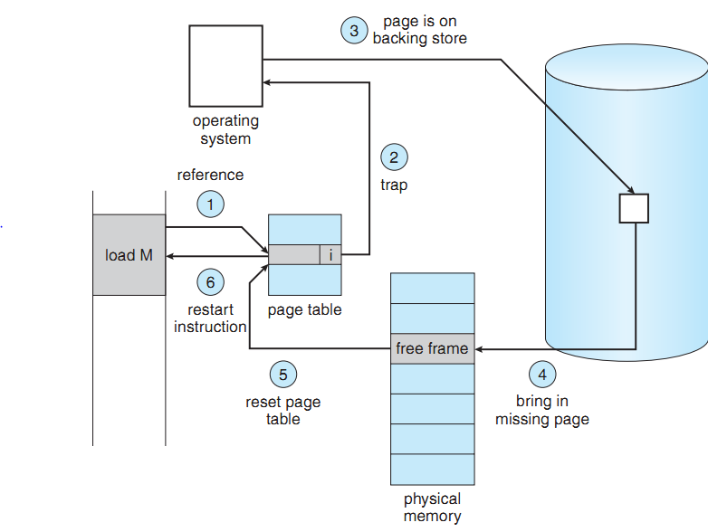
How to handle a page fault
An I memory access
Page fault trap
Find a free frame
Disk I/O
Set V in page table
Resume process
Invalid (I)
Valid (V)
Notes:
1. We check an internal table (usually kept with the process control block) for this process to determine whether the reference was a valid or an invalid memory access.
2. If the reference was invalid, we terminate the process. If it was valid but we have not yet brought in that page, we now page it in.
3. We ﬁnd a free frame (by taking one from the free-frame list, for example).
4. We schedule a disk operation to read the desired page into the newly allocated frame.
5. When the disk read is complete, we modify the internal table kept with the process and the page table to indicate that the page is now in memory.
6. We restart the instruction that was interrupted by the trap. The process can now access the page as though it had always been in memory.

Slide 4
Over–allocating memory
Virtual Memory increase the degree of multiprogramming
Over–allocating memory can improve the CPU utilization and throughput
+ Processes that have spare page frames in their page table
On the other hand, over-allocating may degrade the performance
- Processes that are using all of their pages
- Particular data set with huge memory accesses
- Numerous I/O

Slide 5
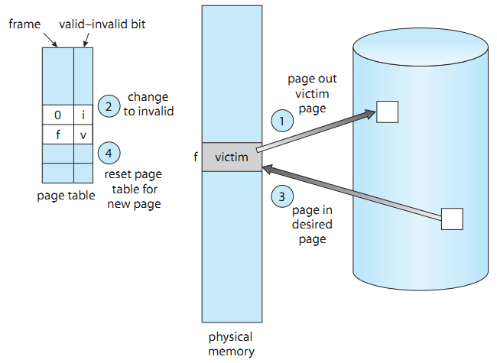
Basic Page Replacement
Page out
Find a free frame
Free?
Not free?
Write to disk
Page in
Update page table
(–) 2 page transfers

Slide 6
Page Replacement
When no page is free in the process working set
Swap a page out and update the page table to use the freed page
Is there any way to reduce the overhead of two page transfers?
The modify bit or dirty bit
Page replacement bridges the gap between Virtual Memory and Physical Memory
Frame allocation algorithms decide how many frames to allocate to each process
Page replacement algorithms select frames that are to be replaced

Slide 7
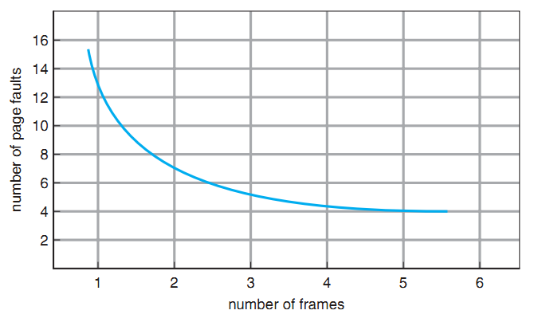
Page Replacement
We evaluate a page replacement algorithm using a Reference String (memory trace)
# frames per process
Page size
# Frames
# Page Faults

Slide 8
FIFO Page Replacement
Policy: FIFO Queue to hold all pages in the memory
Swap out the head of queue
Insert the swapped in page at the tail of queue
Easy to understand and implement
7
0
1
2
0
3
0
4
2
3
0
3
2
1
2
0
1
7
0
1
7
---
---
7
---
0
---
7
---
0
---
1
2
---
0
---
1
2
---
0
---
1
2
---
3
---
1
2
---
3
---
0
4
---
3
---
0
4
---
2
---
0
4
---
2
---
3
0
---
2
---
3
0
---
2
---
3
0
---
2
---
3
0
---
1
---
3
0
---
1
---
2
0
---
1
---
2
0
---
1
---
2
7
---
1
---
2
7
---
0
---
2
7
---
0
---
1
Notes:
# 15 page faults

Slide 9
Optimal Page Replacement
The algorithm that guarantees the lowest possible number of page faults for a fixed number of frames
Requires future knowledge
Policy: Replace the page that won’t be used for the longest period of time
7
0
1
2
0
3
0
4
2
3
0
3
2
1
2
0
1
7
0
1
7
---
---
7
---
0
---
7
---
0
---
1
2
---
0
---
1
2
---
0
---
1
2
---
0
---
3
2
---
0
---
3
2
---
4
---
3
2
---
4
---
3
2
---
4
---
3
2
---
0
---
3
2
---
0
---
3
2
---
0
---
3
2
---
0
---
1
2
---
0
---
1
2
---
0
---
1
2
---
0
---
1
7
---
0
---
1
7
---
0
---
1
7
---
0
---
1
Notes:
# 9 page faults

Slide 10
Not Recently Used (NRU)
Evict the page that is the oldest, preferring pages that are not dirty
Reference Bit (R)
Dirty Bit (D)
Valid Bit (V)
Protection | D | R | V | Page Frame Number
Reference Bit | Dirty Bit | Description
0 | 0 | Best page to replace | First choice
0 | 1 | Page should be written out before replacement
1 | 0 | Probably will be used again soon
1 | 1 | Probably will be used again soon and should be written out before replacement | Last choice

Slide 11


Second Chance Page Replacement
Single Reference Bit: The reference bit contains zero or one
FIFO Queue
Referenced ? Second chance
Unreferenced ? Replace the page

Slide 12
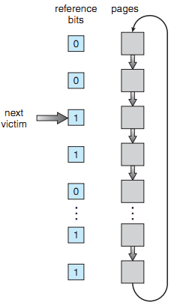
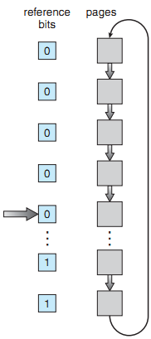
Clock Algorithm
Linked list data structure
When a page fault occurs, the page handle is pointing to the candidate page
R = 0 ? Evict the page
R = 1 ? Clear R and advance hand
7
0
1
2
0
3
0
4
2
3
0
3
2
1
2
0
1
7
0
1
7
---
---
7
---
0
---
7
---
0
---
1
2
---
0
---
1
2
---
0
---
1
2
---
0
---
3
2
---
0
---
3
4
---
0
---
3
4
---
0
---
2
3
---
0
---
2
3
---
0
---
2
3
---
0
---
2
3
---
0
---
2
3
---
1
---
2
3
---
1
---
2
0
---
1
---
2
0
---
1
---
2
0
---
1
---
7
0
---
1
---
7
0
---
1
---
7
000
000
000
000
010
000
010
010
000
000
010
110
111
000
000
000
010
000
100
110
Second Chance

